Slide 1

Mini-project Presentation on TrackItAll
Presented by :- Manav Mittal
Nikhil Agrawal
Kushagra Gupta Vaishnavi Agrawal
Under the Supervision of:-
Ms. Robin Khurana
SCHOOL OF COMPUTER ENGINEERING AND APPLICATIONS
NOV 2023

Slide 2
Introduction
Your all-in-one solution for financial control, task management, and personal reflection.
With the Your Wallet, effortlessly manage your finances and stay on top of your spending.
Stay organized, focused, and in control with TrackItAll – your go-to companion for a well-managed and enriched lifestyle."

Slide 3
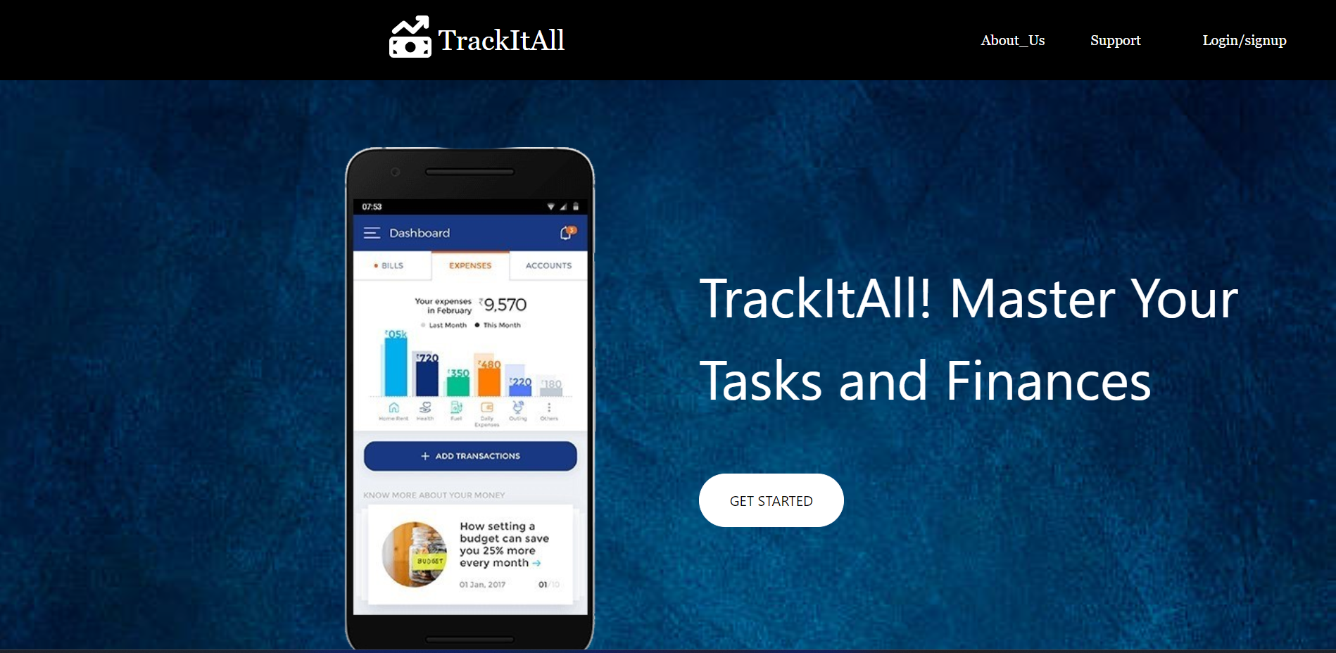
Landing page
Know about our website
Single click for login your page
Helpdesk for our queries
Start our project and enjoy it….

Slide 4
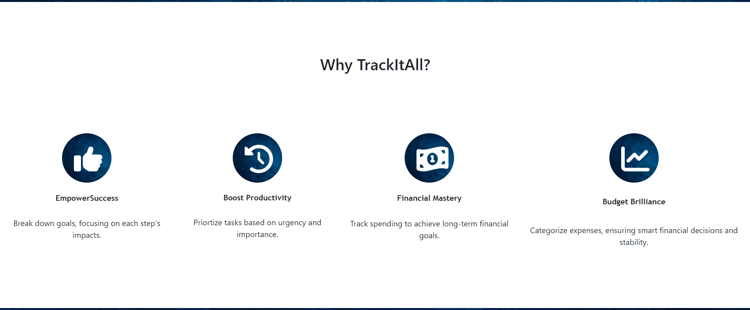
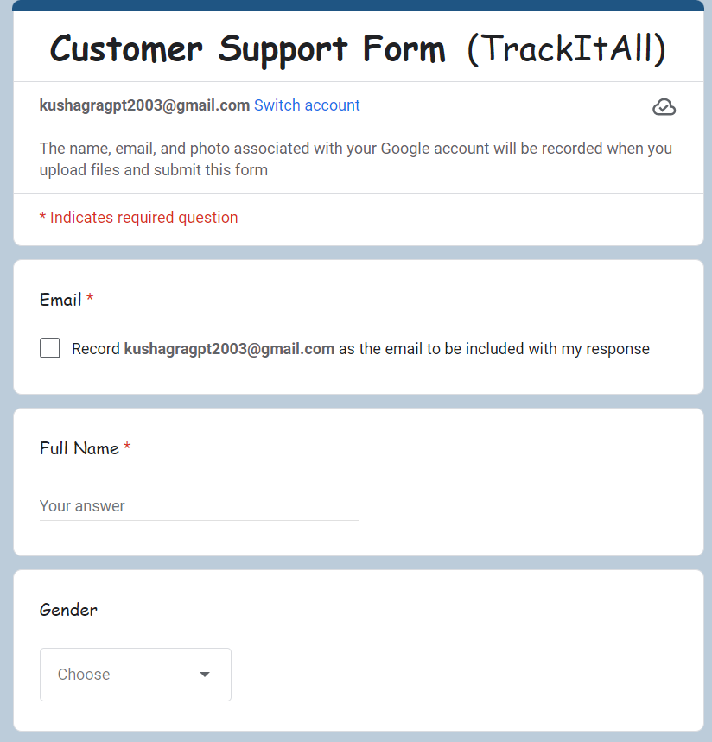
About Us
Support(Form)

Slide 5
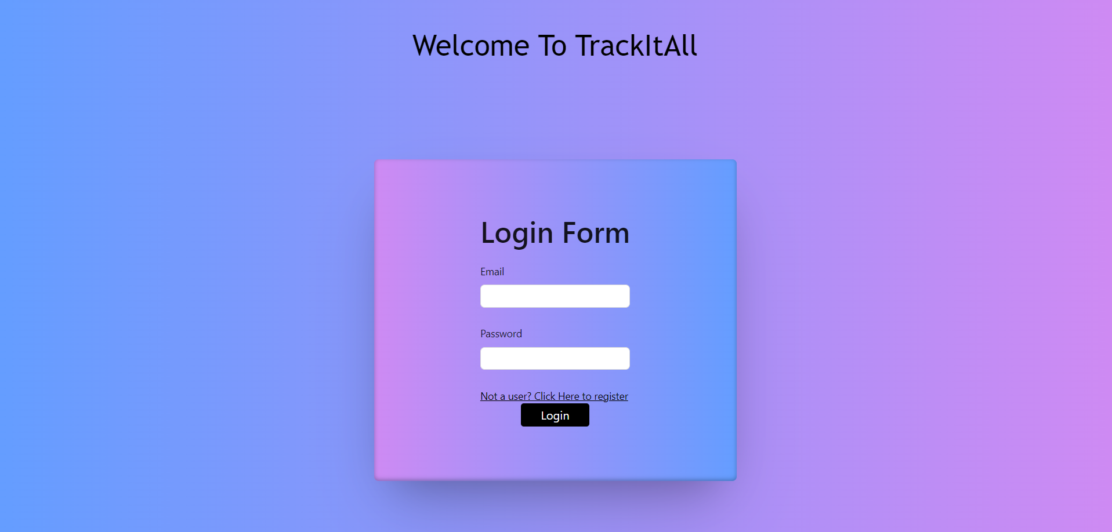
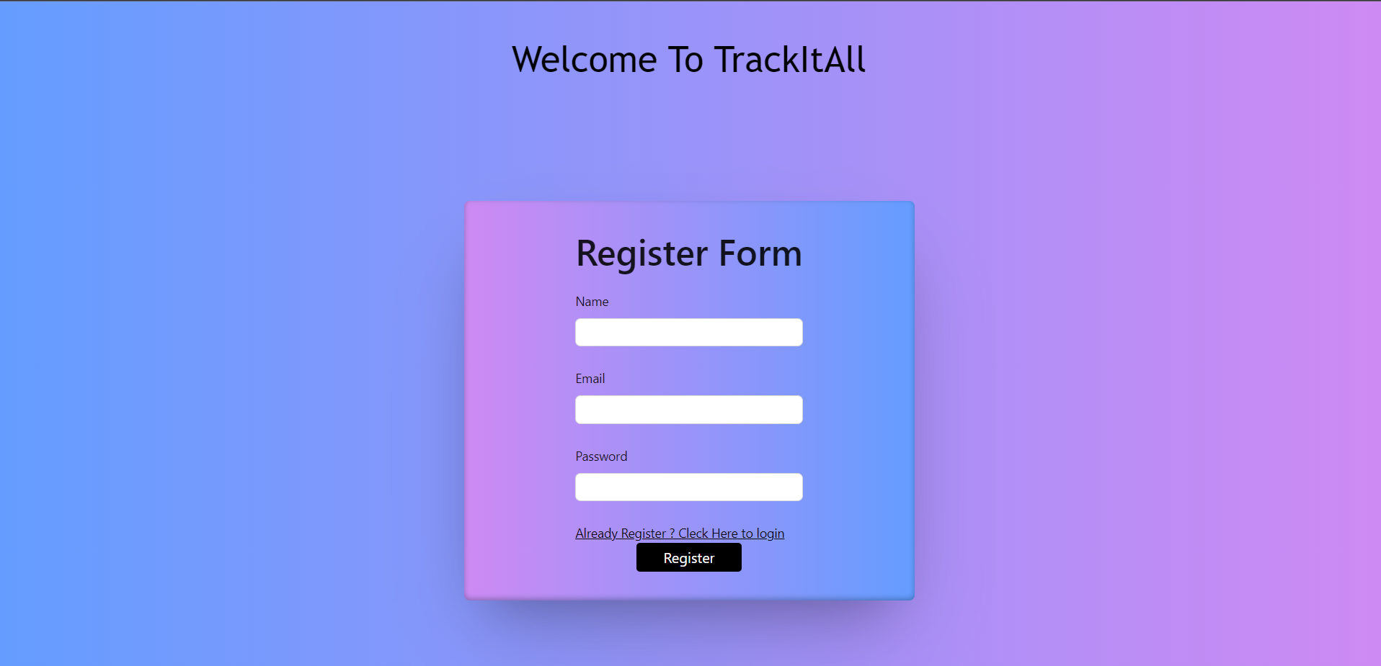
Login/signup page
Enter your Name
Enter your Email
Enter your Email
Enter your Password
Click here to signup
Enter your Password
Click here to signin(if already register)
Click to login
Click to register

Slide 6
Features and their Results
This versatile website brings together three essential functionalities to simplify your daily life.
With the Your Wallet, effortlessly manage your finances and stay on top of your spending.
Keep your tasks in check with the intuitive Task trek feature, ensuring you never miss a deadline or forget an important task.
And finally, capture the moments that matter with the Quick Note.

Slide 7
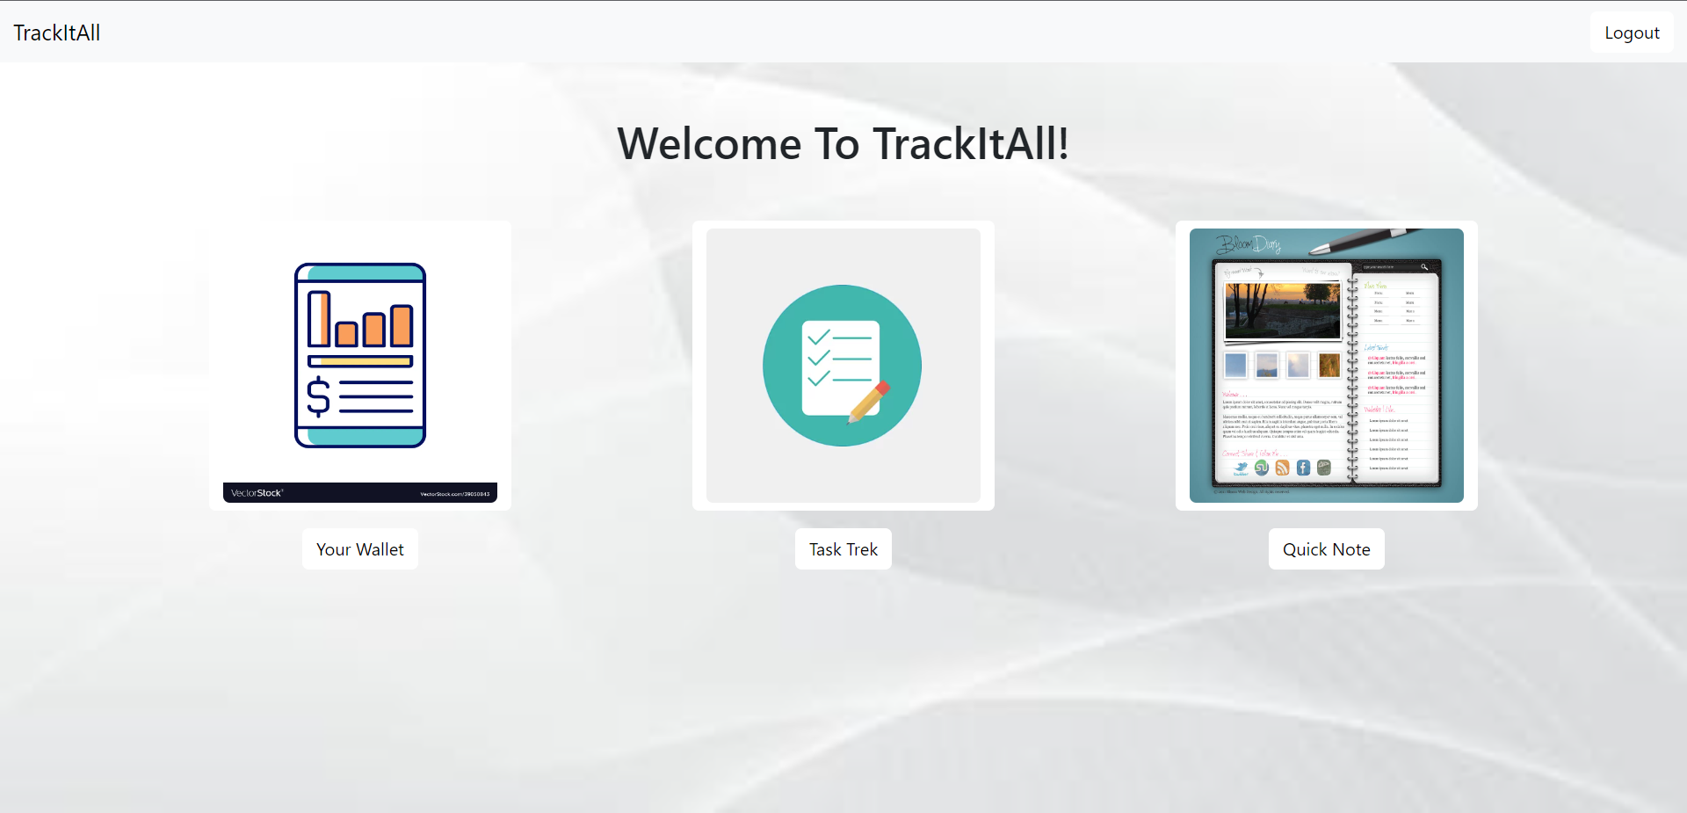
For Logout
Your Wallet
Quick Note
Task Trek

Slide 8
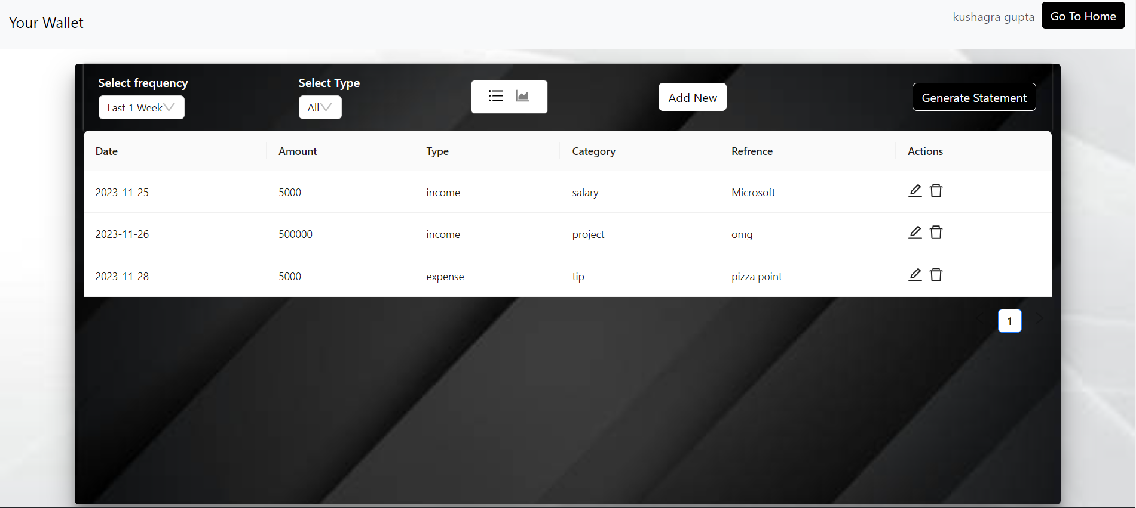
Welcome To Your Wallet
Username
Back to home page
Features add
Print Statements
List of our expenses and incomes

Slide 9
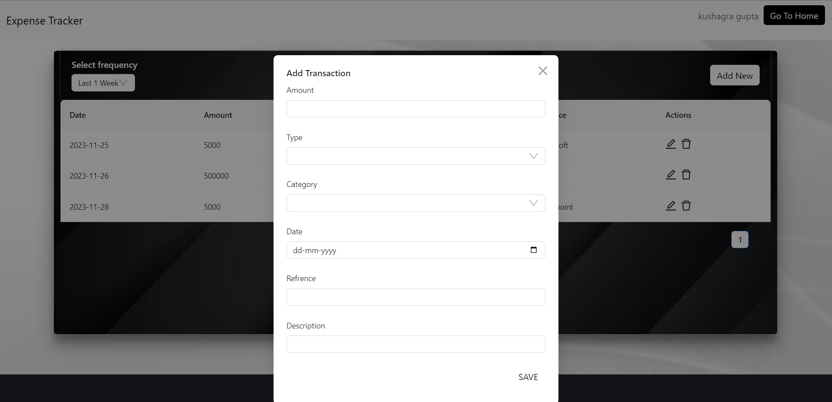
Form for add transaction in our Expense Tracker
Enter your amount
Enter your type
Enter your category
Enter your date
Enter your reference
Enter your description
Save the Form

Slide 10
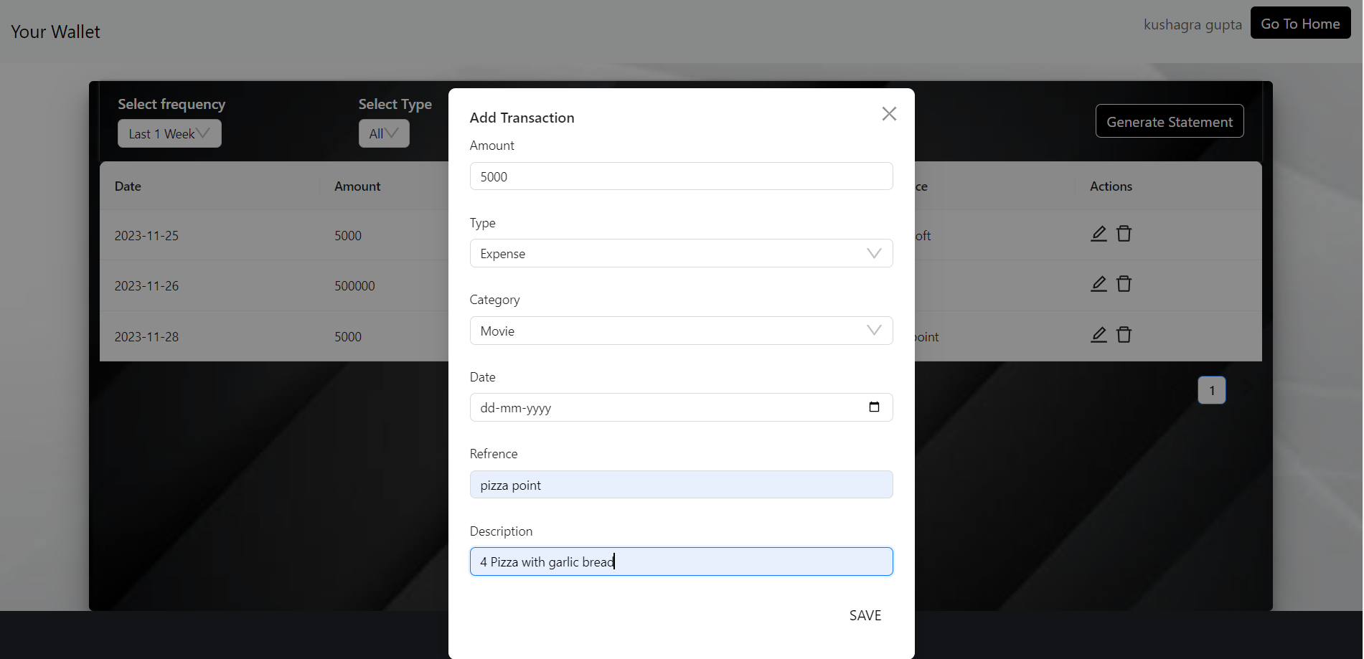
Fill the form like this

Slide 11
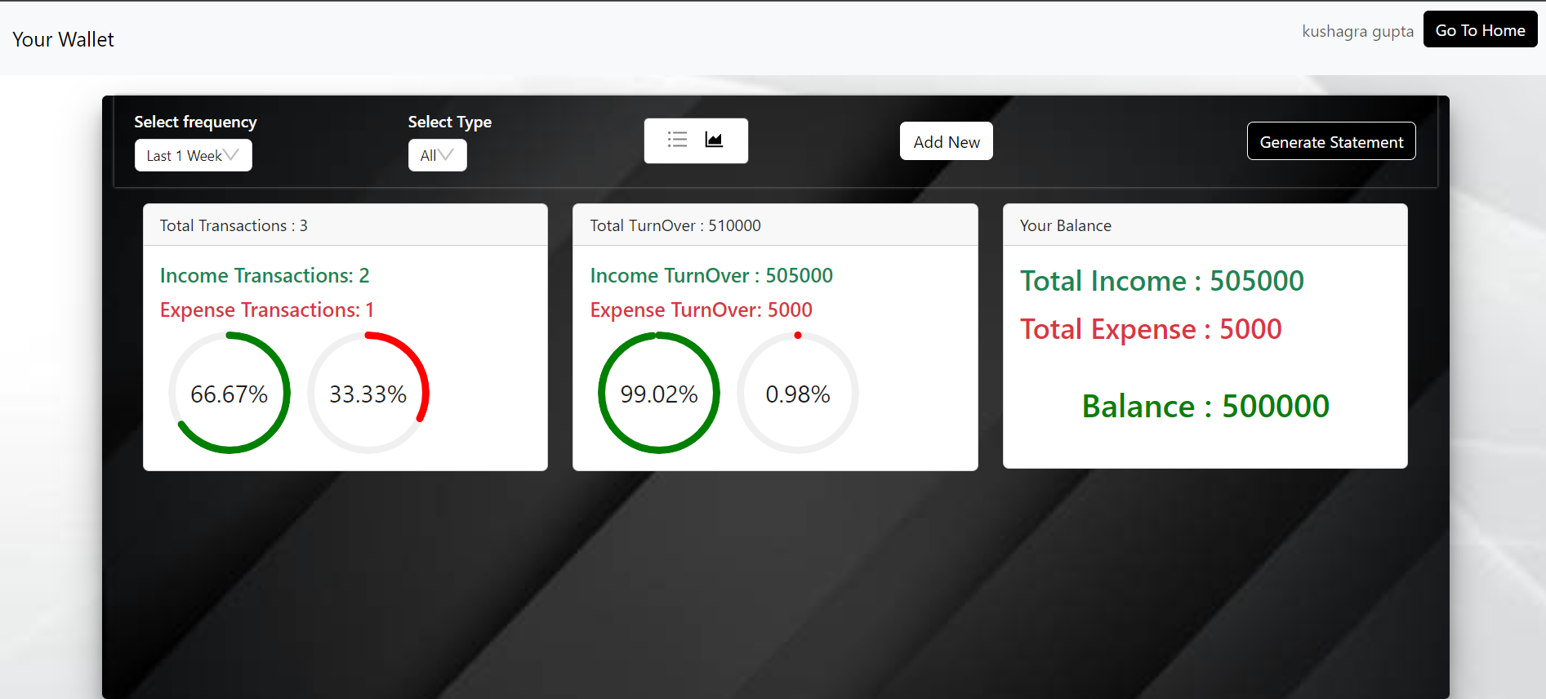
Back to home page
Graph representation for expense tracker data

Slide 12
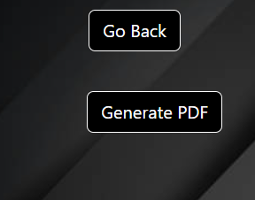
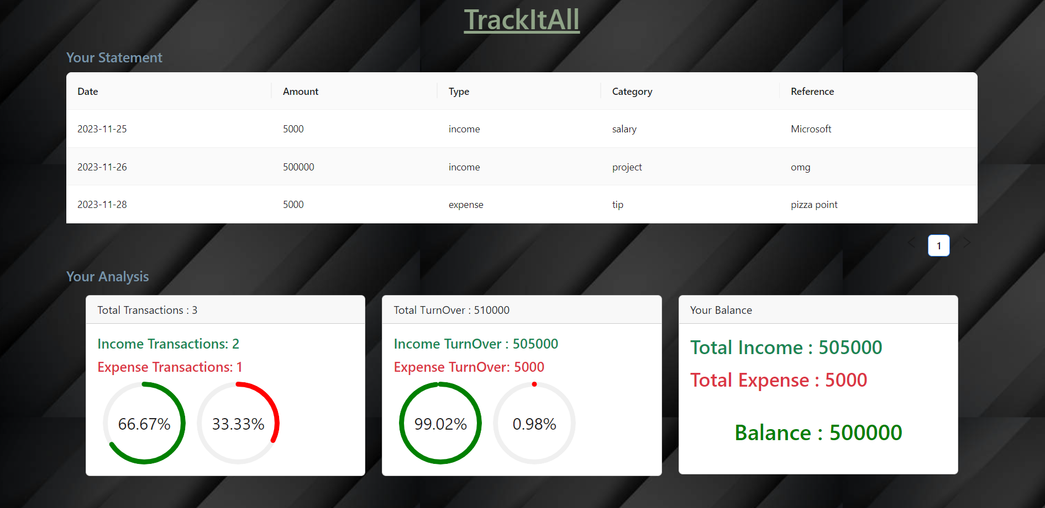
By Clicking on Generate Statement
Generate your pdf of your data
Back to home page
Your Statements
Your Analysis

Slide 13
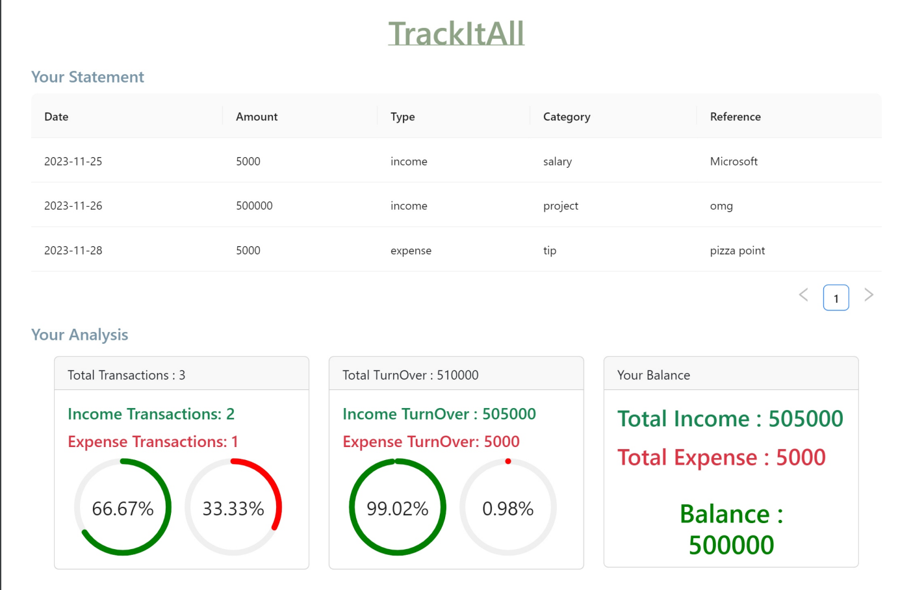
Generated PDF(Result)
Your Statements
Your Analysis

Slide 14
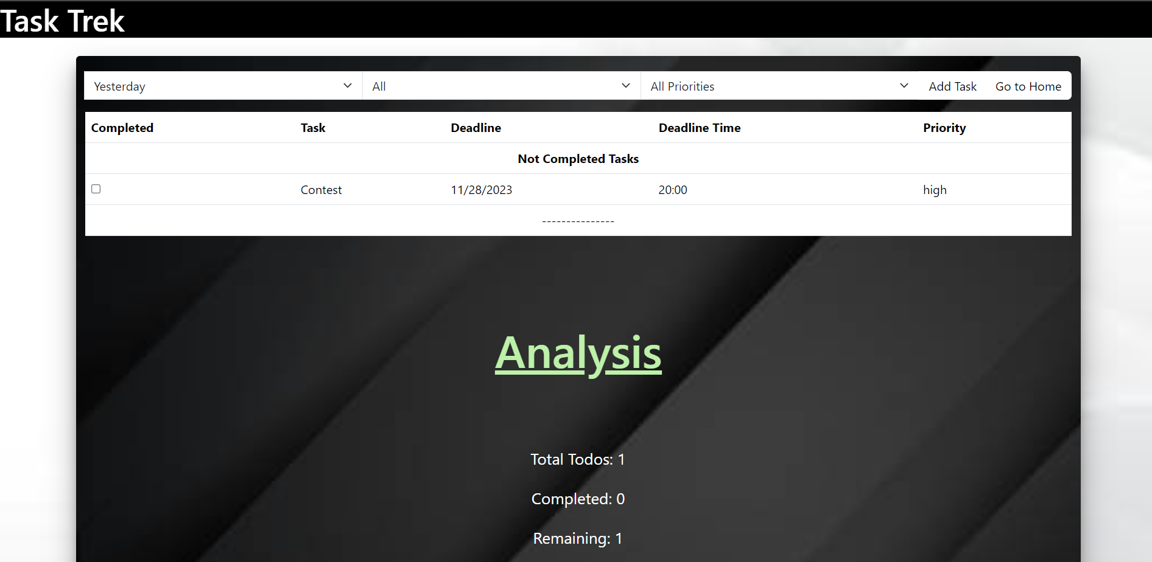
Welcome to Task Trek
Back to home page
All Tasks that you have to do
Some statistics regarding to our todo list

Slide 15
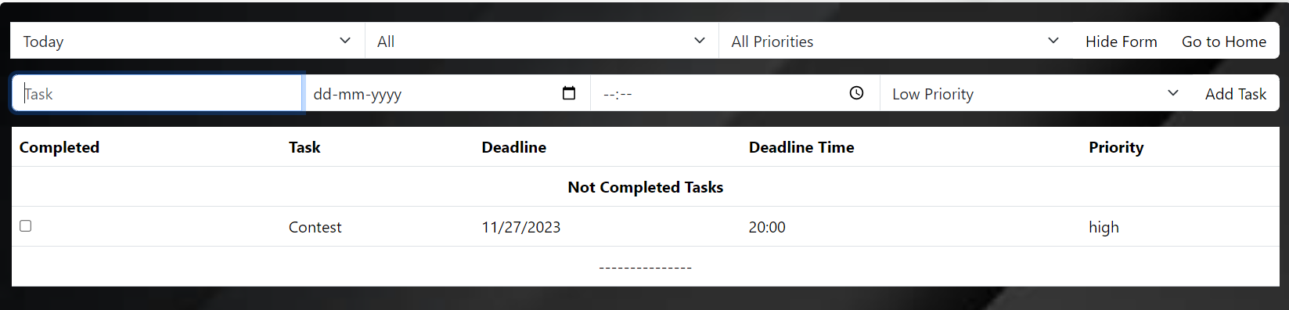
Features:-
Back to home page
Select day
Choose anyone
Select Priority

Slide 16
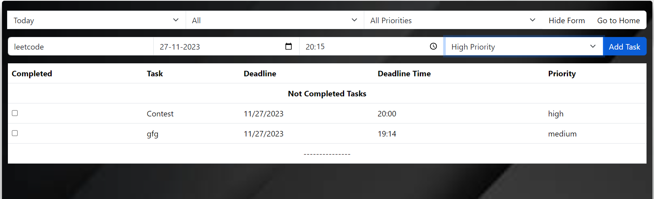
Result:-
Choose Date
Choose Time
Choose Priority acc. To your task
Choose task that you want to do
Form For doing
task
All Tasks that you have to do

Slide 17
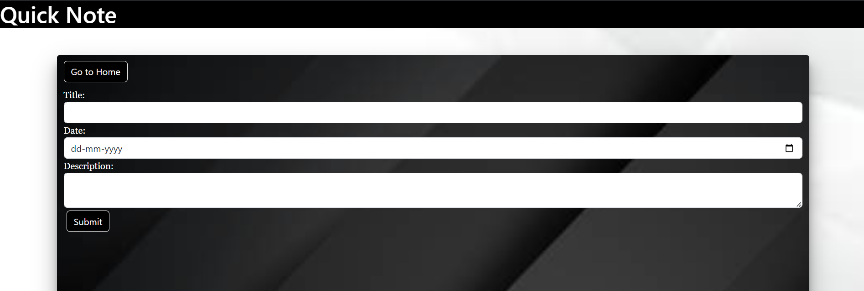
Welcome to Quick Note
Features:-
Back to home page
Title
Date
Description
Submit

Slide 18
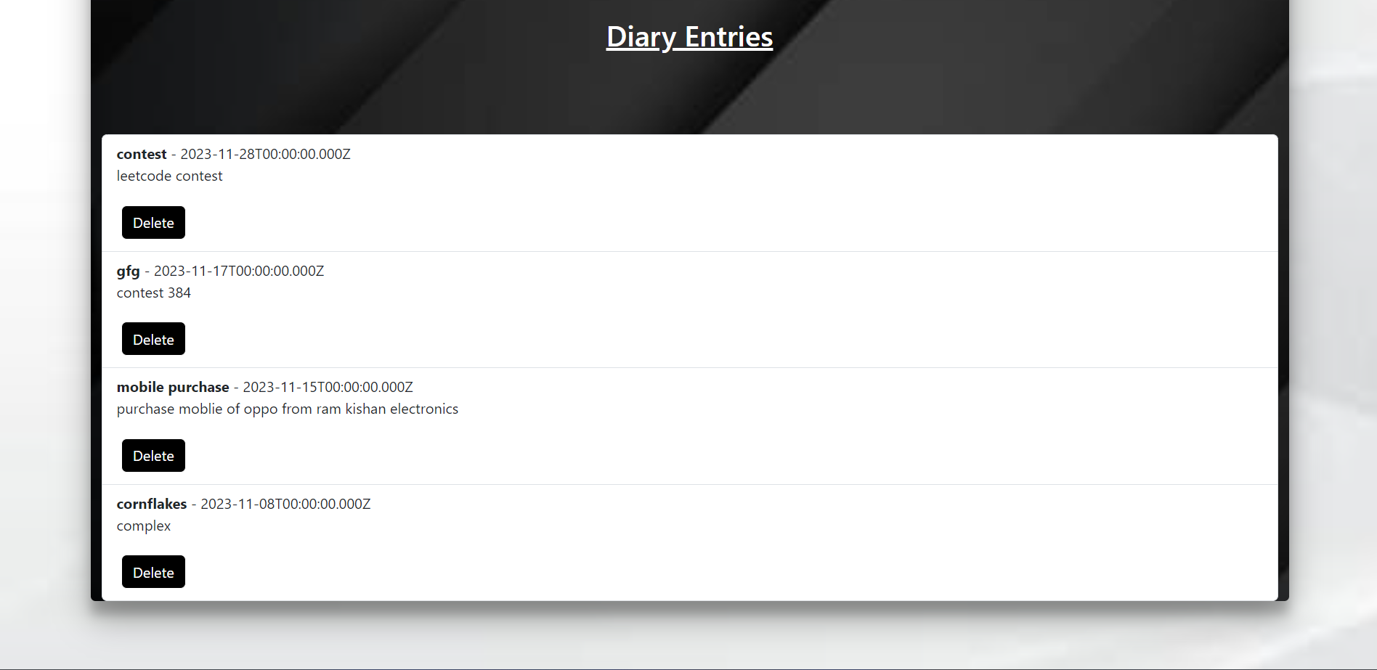
Results:-
Diary Entries
We just delete our records
Records of our Diary

Slide 19
Future Work
Functionality of forgot password
Enhanced Customization Option
Mobile Application Development
Group Task Management

Slide 20
Conclusions
Data privacy and security
Productivity Enhancement
Financial Awareness
Simplified User Experience
Continuous Evolution

Slide 21
Thank You…

